Slide 1

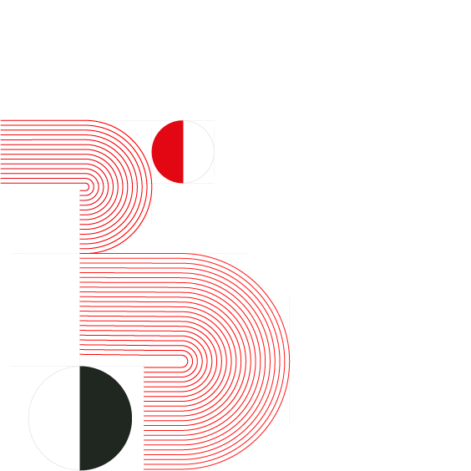

Slide 2

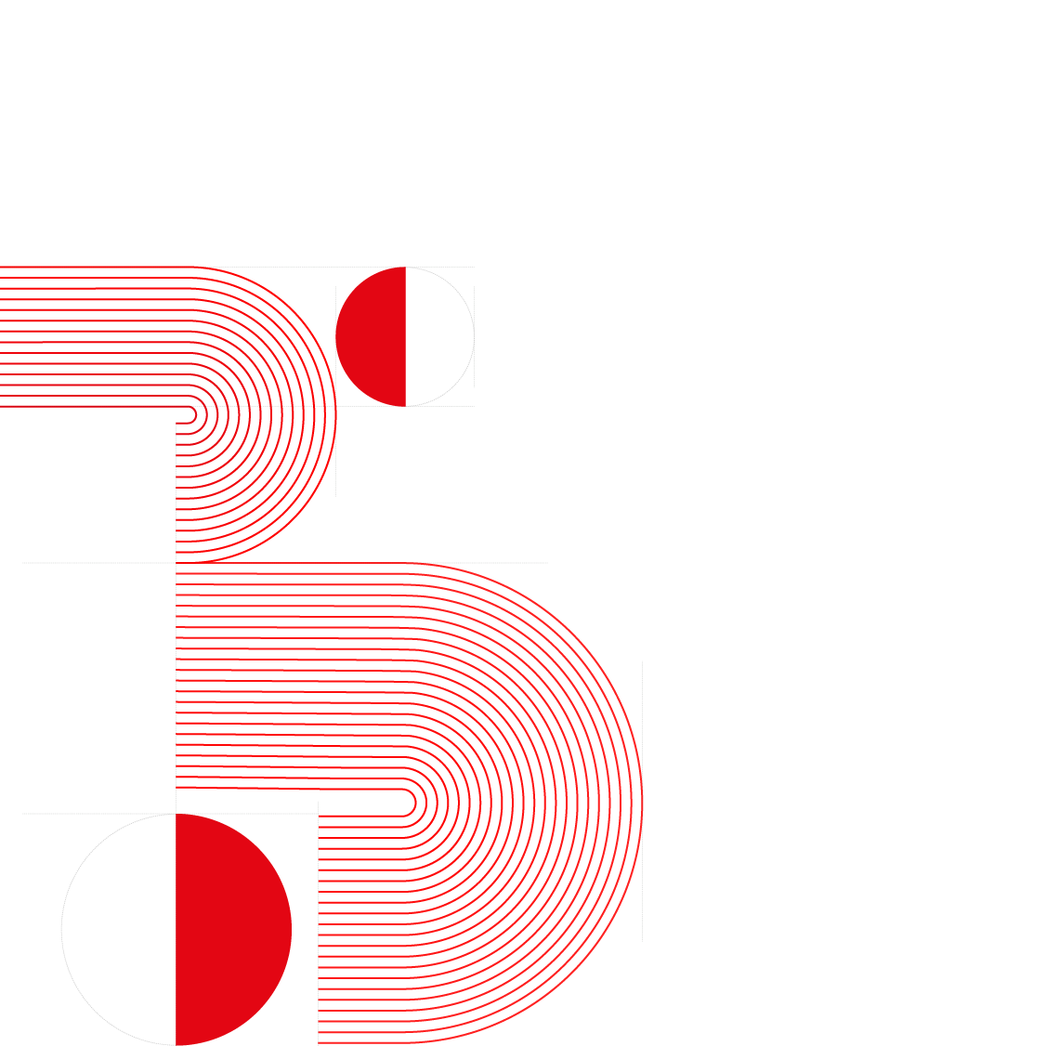
“
“
Transforming Your Brand
Building Relationships
-Lee Kavanagh

Slide 3
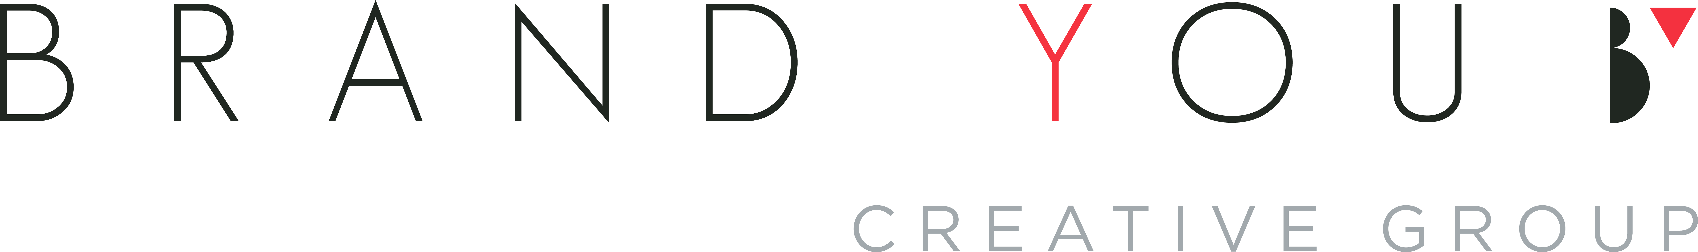
Ireland’s Multi-Award
Winning Branding
& Marketing Agency

Slide 4
Marketing
Case Study

Slide 5
Table of Contents
Treacy’s Carpet and Furniture................
Doyle Concrete.......................................
Mayden Hayes........................................
Dublin Wine To Your Door......................
Bobo’s Burger........................................
Awards…………………………………….
Contact Information………………………
06
12
18
24
30
36
37

Slide 6
Treacy’s Carpet & Furniture

Slide 7
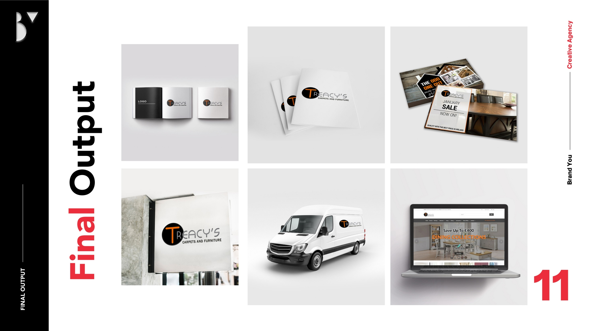
Transforming Treacy’s Carpets and Furniture for the Digital Age
About the Client
Statement of the problem………………………
Treacy’s Carpets and Furniture is a reputable, business that has been a cornerstone of the Irish furniture and flooring industry for over 56 years. Known for their high-quality products and customer-centric approach, Treacy’s had built a legacy of trust. However, as consumer behaviour evolved and the market shifted to the digital landscape, the need for modernization became apparent. For the past 14 years, BrandYou Digital Marketing Agency has been a proud partner in this transformative journey, helping Treacy’s thrive in an increasingly competitive environment.
Despite their longstanding reputation, Treacy’s faced several challenges:
The brand’; image had grown dated, failing to resonate with modern consumers.
A lack of a strong online presence limited their ability to reach a broader audience.
Ineffective targeting strategies struggled to attract the desired customer demographics.
Poor brand positioning in a crowded market hindered their growth potential.
These issues called for a comprehensive overhaul of their branding and marketing strategies to align with the demands of the modern retail landscape.

Slide 8
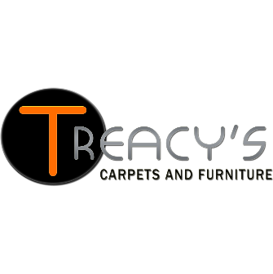
Our Approach & Solution
BrandYou implemented a strategic, multi-faceted approach to address Treacys’ challenges:
  Comprehensive Rebranding
Refreshed Treacys’ visual identity to ensure it appealed to contemporary consumers while respecting the brand’s heritage.
Developed a compelling brand story to deepen emotional connections with customers.
Website Design and Development
Designed a user-friendly, visually engaging website optimized for both desktop and mobile users.
Enhanced website functionality to improve user experience, drive engagement, and increase online sales.
Targeted Marketing Initiatives
Developed tailored marketing strategies incorporating social media campaigns and PPC advertising.
Crafted content that resonated with their target audience, focusing on value propositions and lifestyle integration.
Search Engine Optimization (SEO)
Conducted extensive keyword research and implemented SEO strategies to improve search rankings and organic traffic.
Regularly optimized the site’s content and structure, ensuring sustained growth in online visibility.
Social Media Growth
Built a robust presence on platforms like Facebook, achieving significant follower growth and engagement.
Utilized social media to connect directly with customers and promote brand loyalty.

Slide 9
Achievements and Results.
Our partnership with Treacy’s yielded exceptional results, transforming the brand and significantly enhancing its market presence:
Enhanced Brand Awareness and Visibility
Social media success, including a notable increase to 10,000 followers on Facebook, establishing a vibrant online community.
Strategic SEO efforts led to a 6,665% growth in organic search visibility, with sustained annual growth of 5-10% over the past decade.
Improved Search Engine Rankings
Secured 264 keywords on page one, with 164 in the top three positions and 100 between positions four and ten.
This consistent performance solidified Treacys’ reputation as a market leader in Ireland and beyond.
Record-Breaking Sales Growth
2020 and 2021 became the most successful sales years in Treacys’ 56-year history.
The business achieved a 50% growth in profitability over 14 years, driven by effective marketing and operational excellence.
Sustained Momentum
Continuous growth in subsequent years, demonstrating the enduring impact of our strategies and Treacy’s commitment to innovation.

Slide 10

Our Commitment
This remarkable journey with Treacy’s Carpets and Furniture underscores the transformative potential of a well-executed marketing strategy. At BrandYou Digital Marketing Agency, we are dedicated to empowering brands to achieve their full potential, leveraging innovative solutions and a deep understanding of market dynamics.
If your brand is ready to embark on a transformative journey, let’s work together to achieve unparalleled growth and success.
This remarkable transformation is a testament to our dedication and expertise. Partnering with us opens doors to similar transformative journeys for brands seeking to thrive in today’s dynamic market landscape.

Slide 12
Doyle Concrete

Slide 13
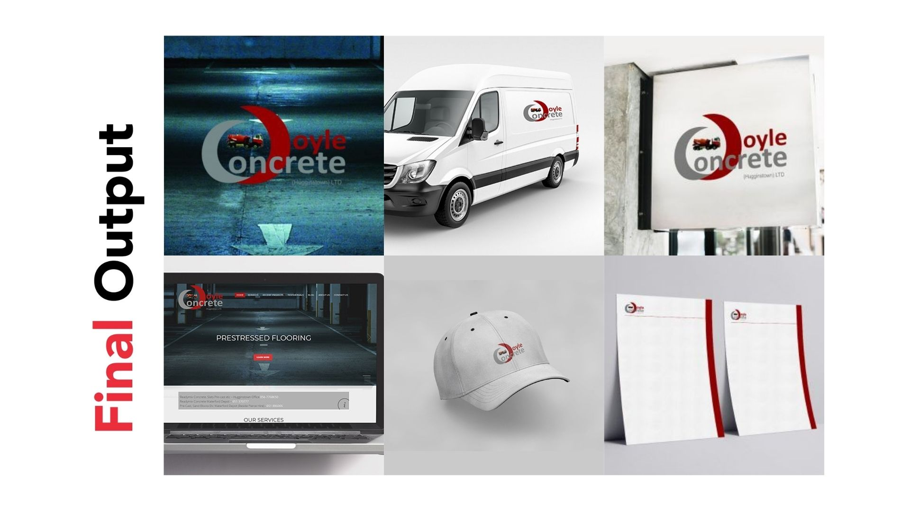
Doyle Concrete - Building a Solid Foundation for Growth
Statement of the problem………………………
About the Client
Despite Doyle Concrete’s longstanding industry presence, they were struggling to convey their brand’s full potential in a rapidly changing market. The company faced several key challenges:
Outdated Brand Identity: Doyle Concrete’s visual identity lacked the modern appeal needed to stand out in a competitive industry.
Limited Digital Presence: Their website and online communication were not optimized for user engagement or showcasing their full range of services and expertise.
Inconsistent Brand Messaging: Their brand did not consistently communicate their core strengths: expertise, reliability, and commitment to quality.
Tight Deadline: Doyle Concrete needed to undergo a complete rebranding—including a new visual identity, website, and digital strategy—within just a few weeks to stay ahead of their competition.
The stakes were high. Doyle Concrete had the potential to solidify its leadership position, but they needed a cohesive and impactful digital presence to tell their story and connect with their audience.
Doyle Concrete started as a company specializing in constructing farm buildings, playing a pivotal role in supporting the agriculture industry. Over time, they expanded their operations and established themselves as one of Ireland’s top suppliers of Ready-mix Concrete and Easy Flow Concrete Mix, essential materials for farm construction and beyond. Whether for large-scale agricultural projects or residential construction, Doyle Concrete has built a reputation for delivering top-quality products and services.
However, as the construction industry evolved, Doyle Concrete faced new challenges: the need to communicate their expertise, showcase their brand’s reliability, and effectively reach both B2B and B2C customers in an increasingly digital world. That is where BrandYou Digital Marketing Agency stepped in, transforming Doyle Concrete’s brand presence and digital footprint.

Slide 14
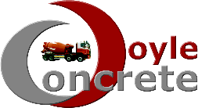
Our Approach & Solution
Recognizing the urgency of Doyle Concrete’s situation, we devised a comprehensive, rapid-action plan to not only meet their short-term needs but also lay the foundation for long-term success. Here’s how we approached the challenge:
Branding and Visual Identity Overhaul
We created a modern visual identity that aligned with Doyle Concrete’s reputation for quality and reliability. We incorporated colors that resonated with the construction and concrete industry—earthy tones of gray, beige, and concrete-inspired hues.
The new branding focused on simplicity and professionalism, making Doyle Concrete feel more approachable while still conveying their authority in the industry.
Bespoke Website Design
The website overhaul was central to Doyle Concrete’s transformation. We developed a UI & UX optimized, bespoke website that provided a seamless experience for both B2B and B2C customers.
The website not only showcased their range of services—ranging from concrete supply to project-based consulting and ongoing support—but also improved functionality with easy navigation and a clear call to action for prospective customers.
Comprehensive Brand and Marketing Strategy
A unified brand and marketing strategy was created to communicate Doyle Concrete’s key message: expertise, reliability, and commitment to quality.
We crafted a cohesive narrative that reflected their legacy while showcasing the company’s forward-thinking approach to modern construction solutions.
Digital Communication Strategy
Doyle Concrete’s digital presence was enhanced with a strong focus on SEO, Google AdWords, and Social Media to increase visibility and drive traffic to the new website.
We also provided video creation, story, and development to bring their brand’s story to life in a visually engaging way, increasing customer trust and engagement.
Vehicle Design & Traditional Marketing Assets
As part of the rebranding effort, we designed new vehicle graphics that transformed Doyle Concrete’s fleet into mobile advertisements, increasing brand visibility on the road.
We also provided all necessary traditional and digital design assets, ensuring consistency across all touchpoints.

Slide 15
Achievements and Results.
With a swift execution of our strategy, Doyle Concrete’s brand transformation was nothing short of remarkable. Here’s a closer look at the results:
Improved Brand Recognition
Doyle Concrete’s new visual identity and rebranded website helped the company establish a stronger presence in the market. Customers now saw the company not just as a provider of concrete, but as a trusted partner in construction.
Enhanced Website Performance
The newly designed website boosted user engagement and conversion rates, allowing Doyle Concrete to more effectively showcase their services and secure more inquiries from potential customers.
SEO and Online Visibility
With the implementation of SEO strategies, Doyle Concrete’s website saw an increase in organic search traffic, leading to better search rankings and greater visibility in search results for key industry terms.
Successful Digital Marketing Campaigns
With Google AdWords campaigns and active engagement on social media, Doyle Concrete witnessed a marked increase in online inquiries. Their presence on platforms like Facebook and LinkedIn grew, helping them connect with both B2B and B2C customers.
Increased Revenue and Market Share
The branding and marketing improvements directly contributed to a growth in both B2B and B2C sales, solidifying Doyle Concrete’s leadership position in Ireland’s competitive construction market.
Meeting Tight Deadlines
Despite the pressure of a few weeks; turnaround, our team delivered everything on time and to a high standard, proving our ability to perform under tight deadlines and exceed client expectations.

Slide 16
Our Commitment
Doyle Concrete’s journey from an outdated brand to a modern, digitally-savvy industry leader is a prime example of how the right marketing strategy can drive remarkable results. By leveraging a comprehensive rebranding, website overhaul, and tailored marketing approach, we helped Doyle Concrete not only overcome their initial challenges but also position themselves for sustained growth.
As a result, Doyle Concrete emerged as a strong competitor in the market, with a clearer identity, stronger customer engagement, and a more robust digital presence.
Just like Doyle Concrete, your business too can face challenges that seem insurmountable. But with the right strategy and expertise, you can transform your brand, build a powerful online presence, and ultimately achieve your business goals. Let BrandYou Digital Marketing Agency be your partner in this journey—together, we can build a strong foundation for your success.
This remarkable transformation is a testament to our dedication and expertise. Partnering with us opens doors to similar transformative journeys for brands seeking to thrive in today’s dynamic market landscape.

Slide 18
Mayden Hayes

Slide 19
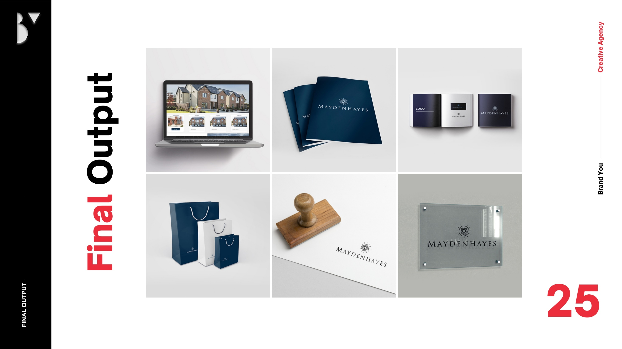
Mayden Hayes - Building Dreams with Targeted Marketing Campaigns
Statement of the problem………………………
When Mayden Hayes approached us, they were navigating a crowded and challenging real estate market. While the development itself offered unparalleled quality, there were several barriers preventing them from achieving their full sales potential:
Limited Market Reach: They needed to attract a diverse audience, including both local buyers and those considering relocating to the area.
Unclear Messaging: The brand struggled to clearly convey its unique value proposition to potential buyers.
Lack of Integrated Marketing Campaigns: Their marketing efforts were scattered, relying on outdated methods and missing out on the benefits of a cohesive digital and traditional approach.
Uncertainty in Direction: The client lacked clarity on how best to position their development and navigate the complexities of modern marketing.
Mayden Hayes needed more than a marketing strategy—they needed a trusted partner who could guide them through the process, ensuring their campaign resonated with the right audience.
Mayden Hayes is a prestigious housing development in Meath, offering luxurious 3, 4, and 5-bedroom family homes. Designed with both style and functionality in mind, these homes represent exceptional value and cater to a broad spectrum of buyers—from growing families to professionals seeking their forever home.
Recognizing the competitive nature of the housing market, the developers of Mayden Hayes partnered with BrandYou Digital Marketing Agency to enhance their brand presence, effectively communicate their value proposition, and drive interest among potential buyers.

Slide 20

Our Approach & Solution
To address Mayden Hayes’ challenges, we developed a tailored strategy designed to maximize visibility, build trust, and drive interest:
Collaborative Discovery Process
We began by working closely with the developers, holding regular in-person and online meetings to deeply understand their goals, challenges, and target audience.
This collaborative approach provided the clarity needed for the Mayden Hayes team to make informed decisions about their brand direction.
Comprehensive Marketing Campaigns
We launched a multi-channel campaign combining digital and traditional marketing techniques to reach diverse audience segments.
Platforms like social media (SMM), SEO, and PPC advertising were employed to enhance visibility and engagement, while traditional channels ensured outreach to local buyers.
Social Media Marketing (SMM)
We created engaging social media content, including virtual home tours, customer testimonials, and community highlights, to connect emotionally with potential buyers
Website Support and Maintenance
A well-functioning website was key to the campaign’s success. We provided ongoing support and maintenance, ensuring that visitors enjoyed a seamless experience while exploring the properties online.
Optimized landing pages and clear calls-to-action guided potential buyers toward scheduling viewings and making inquiries.
Search Engine Optimization (SEO)
By optimizing the website’s content and technical aspects, we improved organic search rankings, ensuring Mayden Hayes was easily discoverable by users searching for luxury housing in Meath.
Pay-Per-Click (PPC) Campaigns
Strategic PPC advertising targeted specific demographics, driving high-quality leads to the website. Ads were tailored to emphasize the unique features of Mayden Hayes homes, such as spacious layouts, family-friendly designs, and competitive pricing.
.

Slide 21
Achievements and Results.
Through our strategic partnership, Mayden Hayes transformed their marketing efforts and achieved outstanding results:
Enhanced Market Reach
The multi-channel campaign successfully targeted diverse audience segments, drawing interest from both local and foriegn buyers selling over 250 houses.
Improved Brand Positioning
Mayden Hayes became synonymous with quality and value in the Meath housing market, effectively establishing itself as a premier choice for families and professionals alike.
Increased Website Traffic and Engagement
SEO optimization and PPC campaigns drove a significant increase in website traffic, with visitors spending more time exploring property listings and contacting the sales team.
The website experienced a reduction in bounce rate, indicating a more engaging user experience.
Higher Lead Generation
Targeted advertising efforts generated high-quality leads, resulting in an increase in inquiries and scheduled property viewings compared to the previous quarter.
Successful Property Sales
Within the first six months of the campaign, Mayden Hayes reported a significant increase in property sales, with several homes sold within weeks of listing.
Stronger Developer Confidence
By involving the client throughout the process, we not only delivered tangible results but also empowered the Mayden Hayes team with the knowledge and tools to sustain their marketing success moving forward.

Slide 22
Our Commitment
Mayden Hayes’ journey demonstrates the power of collaboration, strategic marketing, and a commitment to delivering value to both the client and their audience. From facing unclear messaging and limited reach to achieving record-breaking sales and becoming a trusted brand, Mayden Hayes’ success is a testament to what’s possible with the right approach.
If you’re ready to take your brand to the next level, BrandYou Creative Marketing Agency is here to help. Whether it’s a housing development or any other project, our team is dedicated to crafting tailored solutions that deliver measurable results.
.
This remarkable transformation is a testament to our dedication and expertise. Partnering with us opens doors to similar transformative journeys for brands seeking to thrive in today’s dynamic market landscape.

Slide 24
Dublin Wine
To Your Door

Slide 25
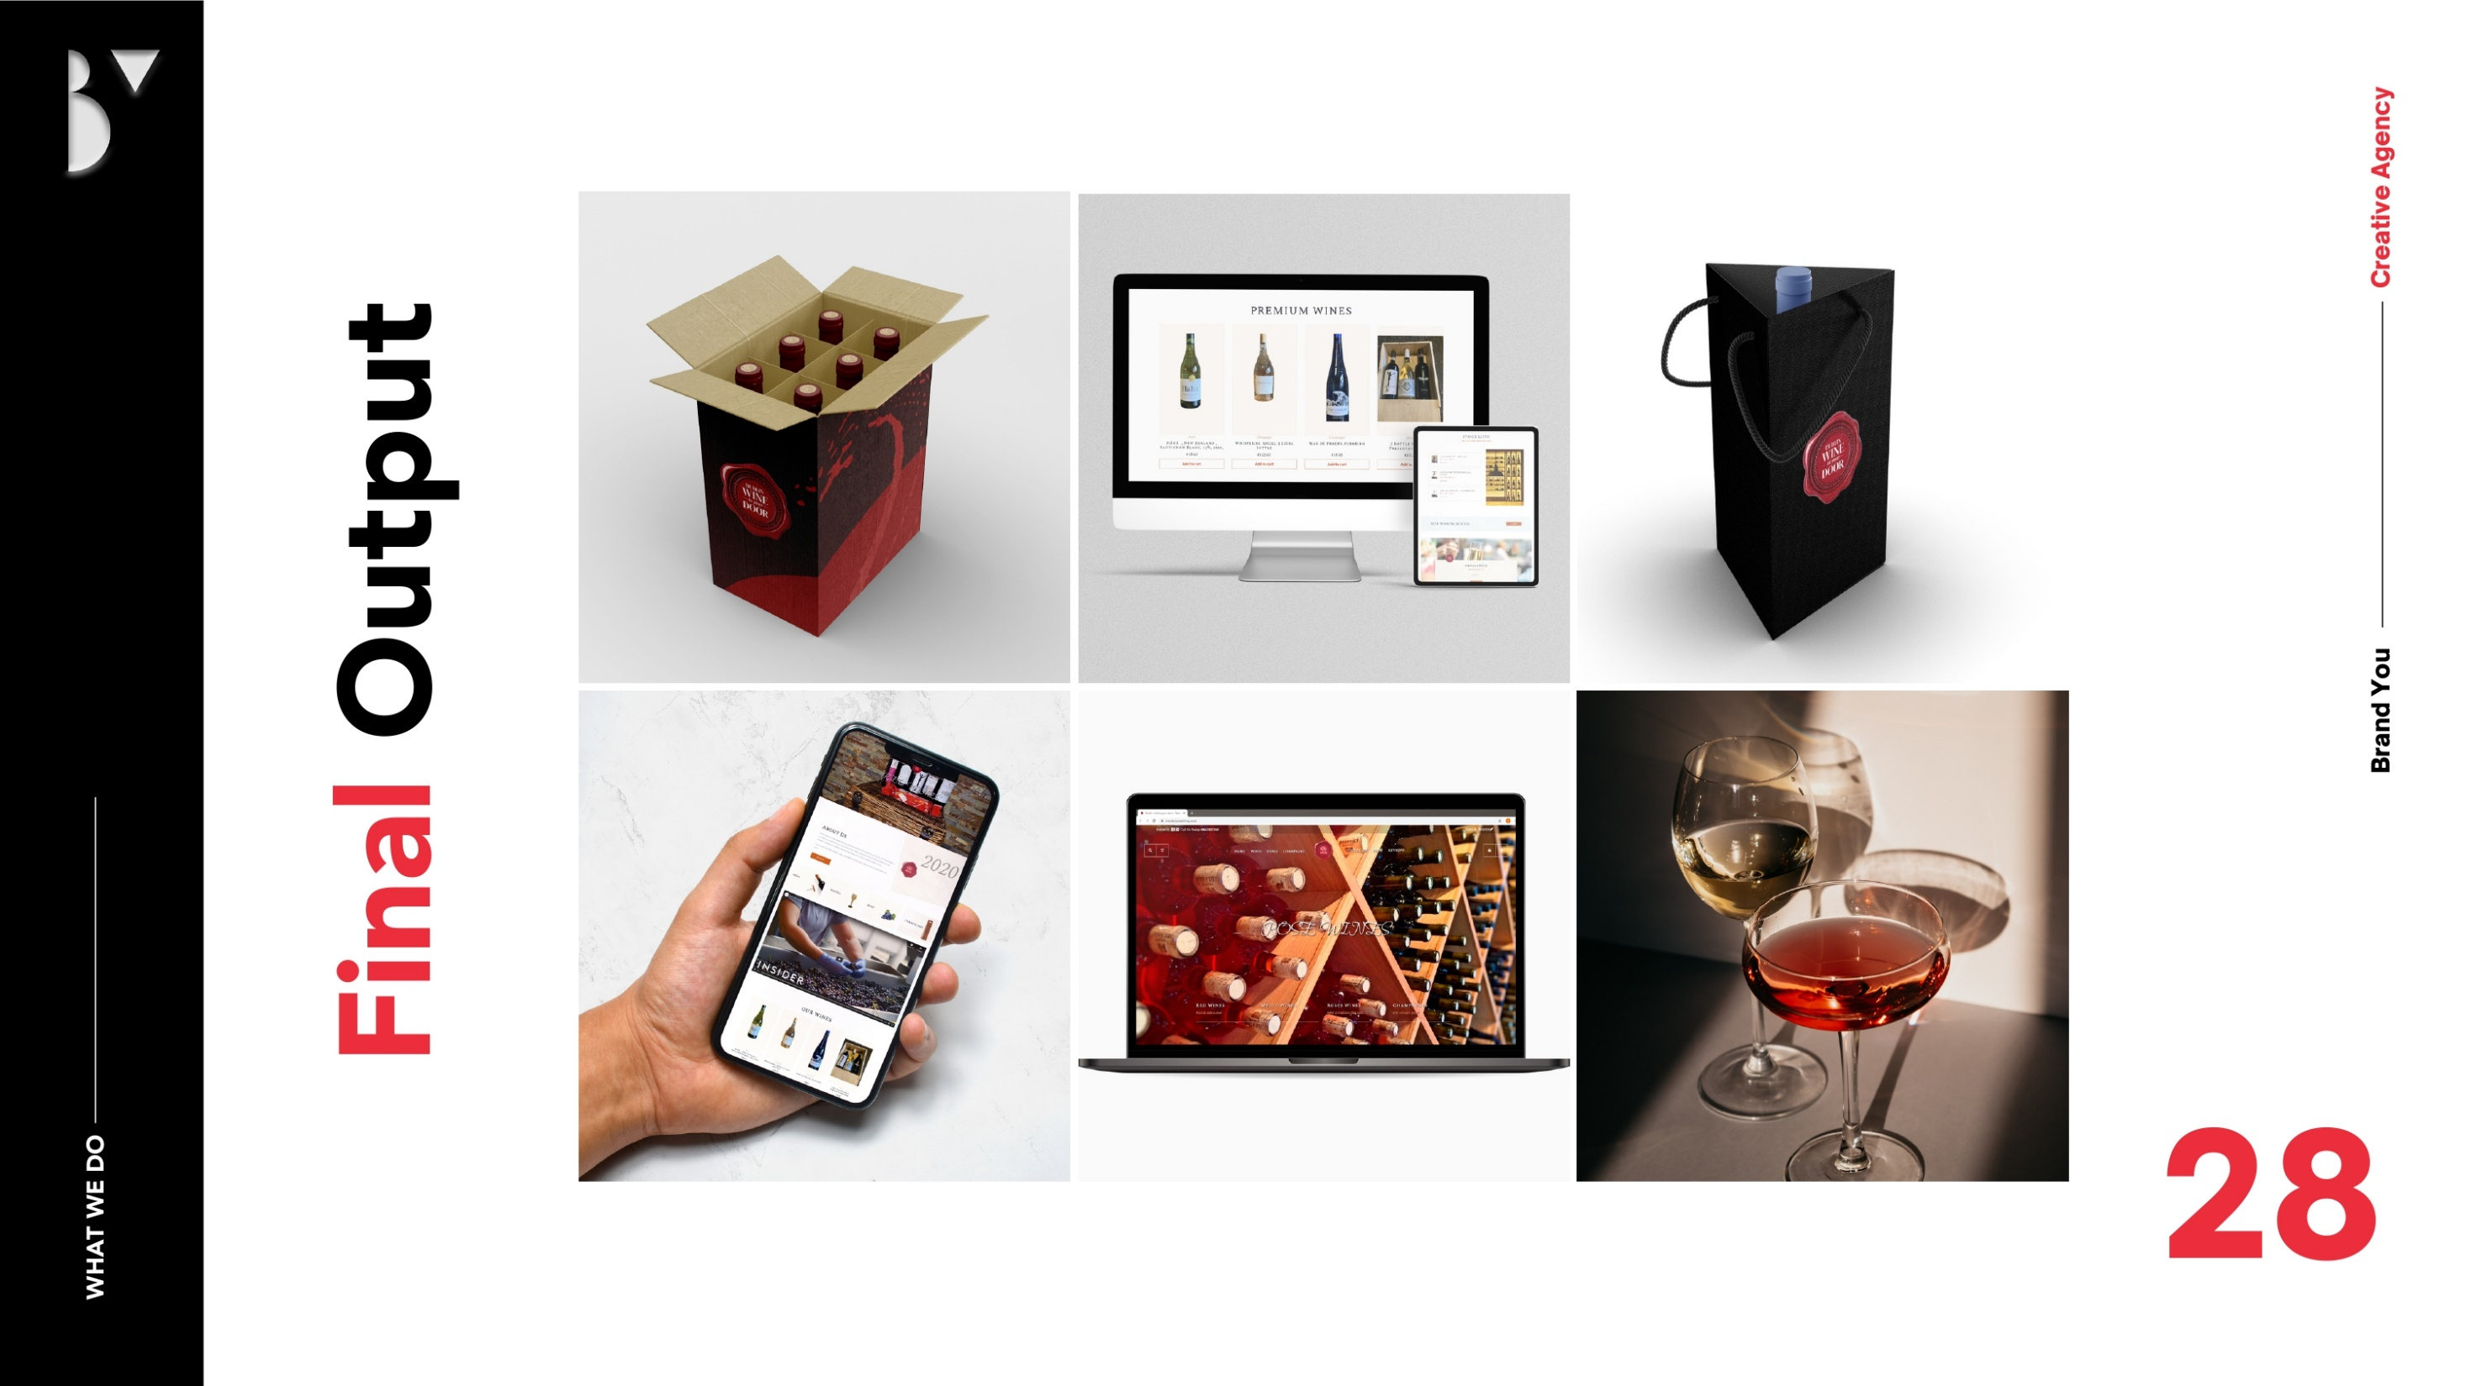
Dublin Wine To Your Door – Uncorking Success in the Digital Marketplace
Statement of the problem………………………
When Dublin Wine To Your Door approached BrandYou Digital Marketing Agency, they faced several significant hurdles:
Limited Online Visibility: Despite offering premium products, the company struggled to compete with established players in the online wine delivery market.
Inefficient E-commerce Platform: The existing website was cumbersome, lacked intuitive navigation, and created friction in the user journey.
Unclear Brand Positioning: The brand had not effectively communicated its unique value proposition to its target audience.
Absence of Strategic Marketing: Without a cohesive strategy, their marketing efforts lacked direction and impact.
No Performance Metrics: There were no systems in place to measure marketing performance or track ROI, leaving the company in the dark about what worked and what didn't.
Dublin Wine To Your Door needed a comprehensive solution to elevate its online presence, streamline the customer experience, and establish itself as Ireland’s premier wine delivery service.
Dublin Wine To Your Door is a Ireland-based wine delivery service dedicated to bringing restaurant-quality wines directly to customers’ homes. Offering a curated selection of premium red, white, rosé, and sparkling wines, the company prides itself on value, convenience, and prompt delivery.
Their mission? To make buying wine online safe, seamless, and accessible while delivering an exceptional experience to wine enthusiasts across Ireland.

Slide 26
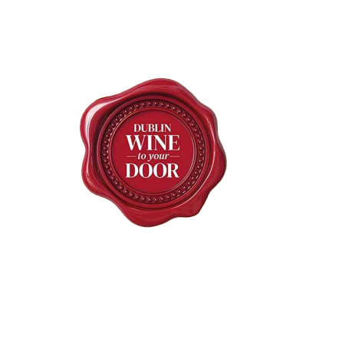
Our Approach & Solution
Content Creation and SEO
Our team created engaging content, including keyword-optimized blogs, product descriptions, and articles that highlighted wine pairings, tips, and stories.
On-site visits ensured high-quality imagery, showcasing the wines in an aspirational and inviting manner.
Social Media and Google AdWords
We launched targeted social media campaigns and Google AdWords advertisements to increase visibility and drive traffic to the website.
A monthly social media calendar provided a consistent flow of engaging posts, enhancing audience engagement.
Performance Tracking
A robust digital reporting system was implemented, allowing the client to monitor key performance indicators (KPIs) and make data-informed decisions.
Metrics included website traffic, conversion rates, ad performance, and audience engagement.
Guidance and Recommendations
Our consultancy extended to marketing guidelines, equipping the client with the tools to sustain their growth beyond the initial campaign.
At BrandYou, we crafted a tailored plan to address Dublin Wine To Your Door’s challenges, blending creativity with strategy to deliver impactful results:
Brand Development Consultancy
We worked closely with the client to refine their brand identity, ensuring it resonated with their target market of wine enthusiasts.
Our efforts focused on communicating the brand’s premium quality, convenience, and reliability.
E-commerce Website Redevelopment
We completely overhauled their website, prioritizing user-friendly navigation, seamless functionality, and an optimized mobile experience.
The site was designed to make browsing, selecting, and purchasing wines effortless, enhancing the overall customer journey.
Strategic Marketing Plan
After conducting a comprehensive audit of three competitors, we developed a data-driven strategy to position Wine To Your Door as a market leader.
A 3-month action plan outlined clear goals, a set budget, and a strategy to reach their audience effectively.

Slide 27
Achievements and Results.
Through our collaboration, Wine To Your Door achieved remarkable growth and established itself as a leader in the wine delivery market:
Enhanced Online Presence
The revamped website saw a significant increase in organic traffic within the first two months of launch.
SEO efforts secured prominent rankings for key terms like "premium wine delivery Dublin" and "buy wine online Ireland."
Improved Customer Experience
Website updates led to a reduction in cart abandonment rates and an improvement in checkout speed.
Customers praised the intuitive interface, making it easier to browse, compare, and purchase wines.
Strategic Marketing Success
Targeted Google AdWords campaigns resulted in an increase in sales, with a strong ROI on advertising spend.
Social media platforms experienced a surge in engagement, with Instagram and Facebook followers constantly growing.
Informed Decision-Making
The newly implemented reporting system enabled Dublin Wine To Your Door to track performance and refine strategies, ensuring sustained growth.
Increased Revenue
Over the course of the three-month campaign, the company reported a significant increase in revenue, driven by both new customer acquisitions and repeat sales.

Slide 28
Our Commitment
Dublin Wine To Your Door’s story is one of transformation. By embracing modern marketing strategies and optimizing their digital presence, they turned their challenges into opportunities and achieved their goals.
Their success highlights the power of a tailored approach, creative problem-solving, and collaboration. At BrandYou Digital Marketing Agency, we’re passionate about helping businesses like Dublin Wine To Your Door thrive in very competitive markets.
Are you ready to elevate your brand’s success story? Let’s work together to achieve your goals. Contact us today to begin your journey!
.
This remarkable transformation is a testament to our dedication and expertise. Partnering with us opens doors to similar transformative journeys for brands seeking to thrive in today’s dynamic market landscape.

Slide 30
Bobo’s Burgers

Slide 31
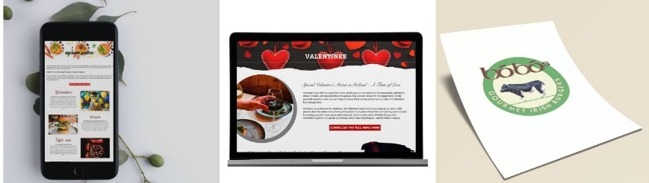
How BrandYou Creative Transformed Bobo’s Burgers into Dublin’s Digital Dining Star
About the Client
Statement of the problem………………………
Established in 2006, Bobo’s Burgers is a Dublin-based restaurant celebrated for its gourmet Irish burgers, crafted from premium, locally sourced ingredients. Known for its innovative flavor combinations and stylish decor, Bobo’s offers a warm ambiance that draws locals and tourists alike. With locations on Wexford Street, Dame Street, and Middle Abbey Street, it has become a cornerstone of Dublin’s dining scene, renowned for its commitment to quality and innovation.
Despite its popularity, Bobo’s faced challenges in the highly competitive hospitality industry. The restaurant’s digital presence didn’t match the exceptional quality of its dining experience. Their website lacked a modern user experience, consistent branding, and optimized visibility in search engine rankings. This hindered their ability to attract new customers and differentiate themselves in a saturated market.

Slide 32
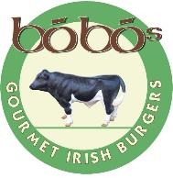
Our Approach & Solution
At BrandYou Creative, we recognized that Bobo’s Burgers needed more than a simple redesign—they required a comprehensive branding and digital strategy to enhance their online presence and communicate their unique value proposition.
Strategic Planning:
We conducted an in-depth consultation and analysis of Bobo’s market positioning. Through meticulous research, we identified gaps in their online presence and developed a cohesive marketing plan tailored to their needs.
Website Redesign:
Designed a user-friendly, visually engaging website with an optimized UI/UX interface.
Developed customized pages, forms, and menu layouts that aligned with their brand identity.
Integrated hosting services to ensure seamless functionality.
Content Creation & SEO:
Curated SEO-rich content to target keywords relevant to their audience, increasing their online visibility.
Crafted creative text for the website, ensuring clear communication of their brand story and offerings.
Conducted keyword research to maximize search engine optimization.
Digital Marketing:
Launched PPC campaigns and Facebook marketing strategies to increase their reach.
Set up Google Analytics and Search Console for performance tracking and insights.
Claimed and optimized their Google My Business profile to improve local search visibility.
Visual Identity Development:
Refined their logo and graphics for a cohesive, modern look.
Designed impactful marketing materials such as brochures and menus.
Client Empowerment:
Delivered a detailed CMS manual and provided personalized training to equip the client with the tools to manage their website independently.

Slide 33
Achievements and Results.
Enhanced Online Presence:
Bobo’s new website saw a drastic increase in traffic within three months of launch. The improved design and functionality resulted in higher engagement and longer site visits.
  Improved Search Rankings:
  With targeted SEO strategies, Bobo’s ranked higher for key terms such as “gourmet burgers in Dublin” and “best dublin burgers,”
  leading to a significant increase in organic traffic.
  Stronger Brand Identity:
  The cohesive visual and content strategy effectively communicated their values and offerings, positioning Bobo’s as a leader in
  Dublin’s hospitality scene.
  Increased Customer Engagement:
  Social media campaigns and a revamped Google My Business profile generated more inquiries and bookings, directly impacting
  their bottom line.

Slide 34
Our Commitment
At BrandYou Creative Agency, we believe every business has the potential to stand out with the right strategy and tools. Our expertise in branding, web design, and digital marketing ensures tailored solutions that drive measurable results.
Just as we assisted Bobo’s Burgers thrive in a competitive market, we’re ready to help you achieve your goals. Whether you need a stronger online presence, a refreshed visual identity, or a full-scale digital marketing strategy, we’re here to guide you every step of the way. Let us help you become the hero of your own success story.
This remarkable transformation is a testament to our dedication and expertise. Partnering with us opens doors to similar transformative journeys for brands seeking to thrive in today’s dynamic market landscape.

Slide 35


Slide 36
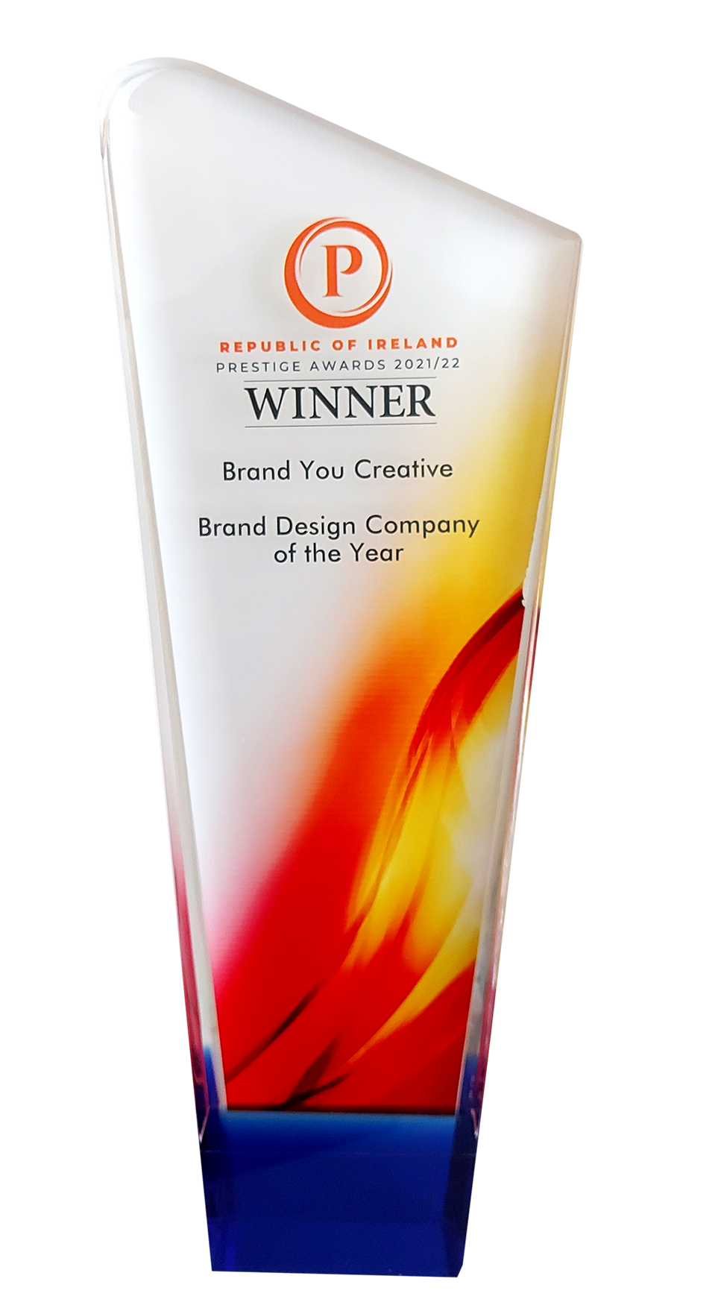
Multi – Award winning Branding & Marketing Agency
Over a Consecutive Number of Years

Slide 37









Contact Information
ADDRESS
Keepers Cottage , 3 Dublin Road
Leixlip Co. Kildare
W23H3C4 Ireland
EMAIL ADDRESS
lee@brandyou.ie
www.brandyou.ie
PHONE NUMBER
Dublin +353 1 270 9501
Dublin +353 1 270 8997
Mobile +353 85 251 2558

Slide 38
